Slide 1
Formal Methods in Software Engineering
Petri Nets Model

Slide 2
Petri Nets Model
Petri Nets were developed originally by Carl Adam Petri, and were the subject of his dissertation in 1962.
Since then, Petri Nets and their concepts have been extended, developed, and applied in a variety of areas.
Applies to concurrent and distributed systems
Follows a model-oriented approach to specification
  States, Transitions

Slide 3
The Basics
A Petri Net is a collection of directed arcs connecting places and transitions.
Places may hold tokens.
The state or marking of a net is its assignment of tokens to places.
Place with token
P1
Arc with capacity 1
T1
Place
Transition
P2

Slide 4
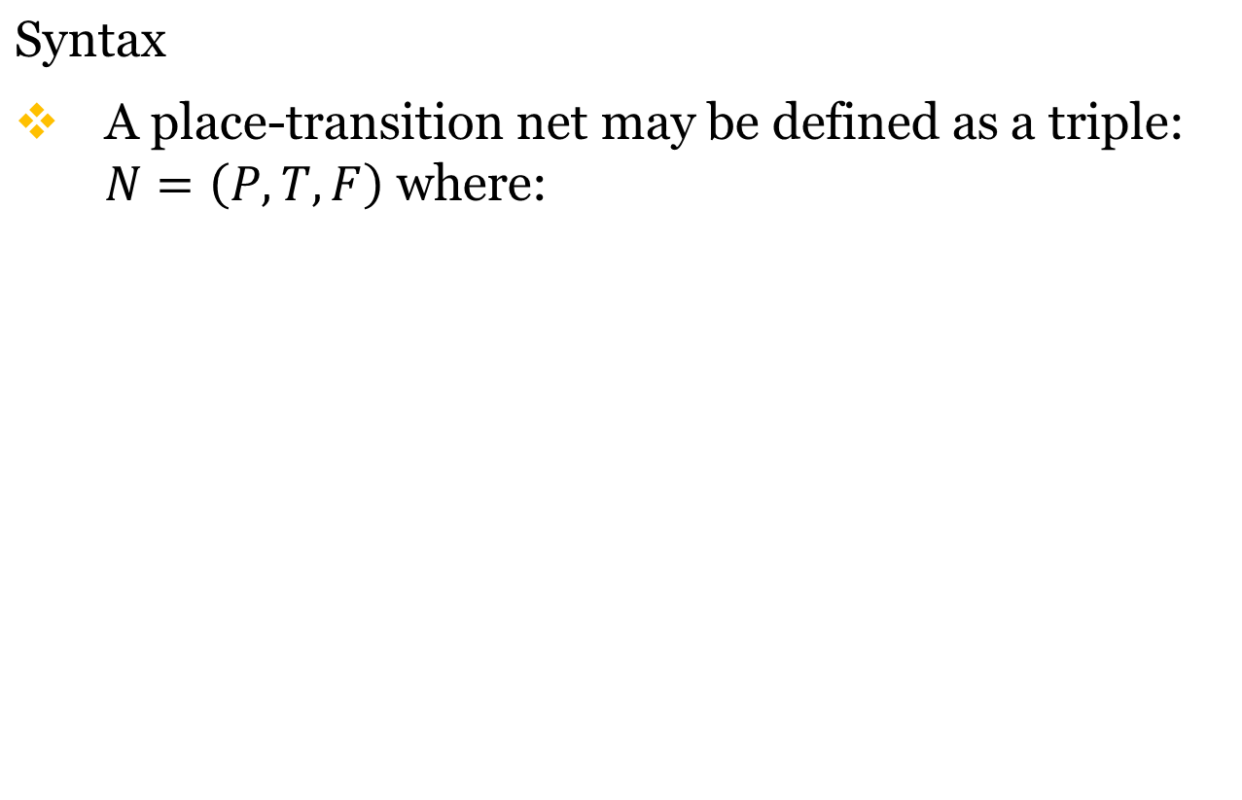

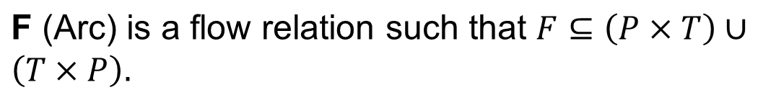
Low-Level Petri Nets
P is a finite set of places represent activities or conditions denoted by the symbols
T is a finite set of transitions represented by the symbols (Bar)
Notes:
Note that there are many variations but in this course we will look at Place Transition Nets

Slide 5
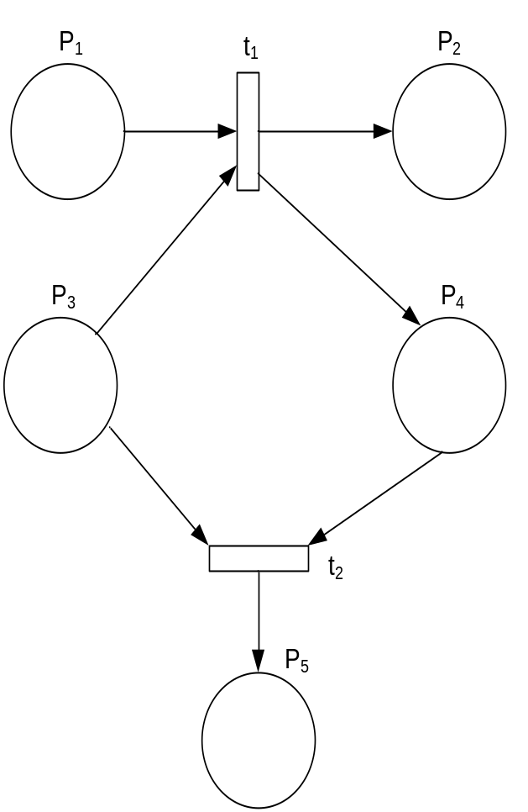
Low-Level Petri Nets (cont’d)
Example
Specify P, T, and F
P = { P₁, P₂, P₃, P₄, P₅ }
T = { t₁, t₂ }
F = { (P₁, t₁), (t₁, P₂),
(P₃, t₁), (t₁, P₄),
(P₃, t₂), (P₄, t₂),
(t₂, P₅) }

Slide 6
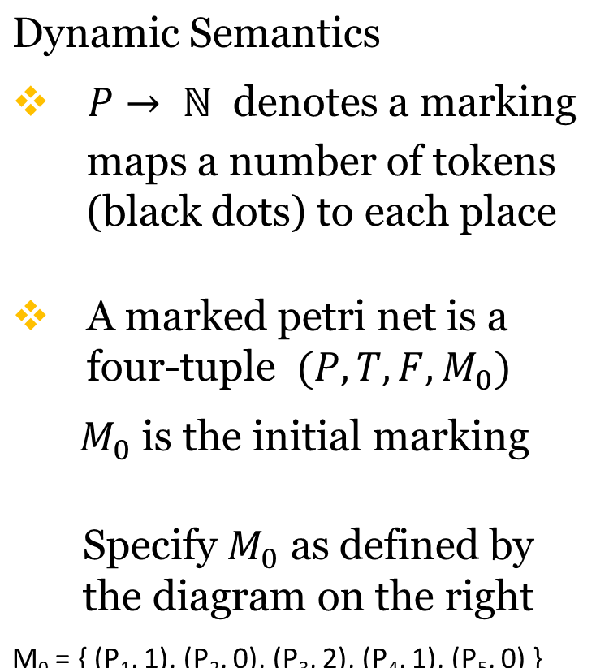
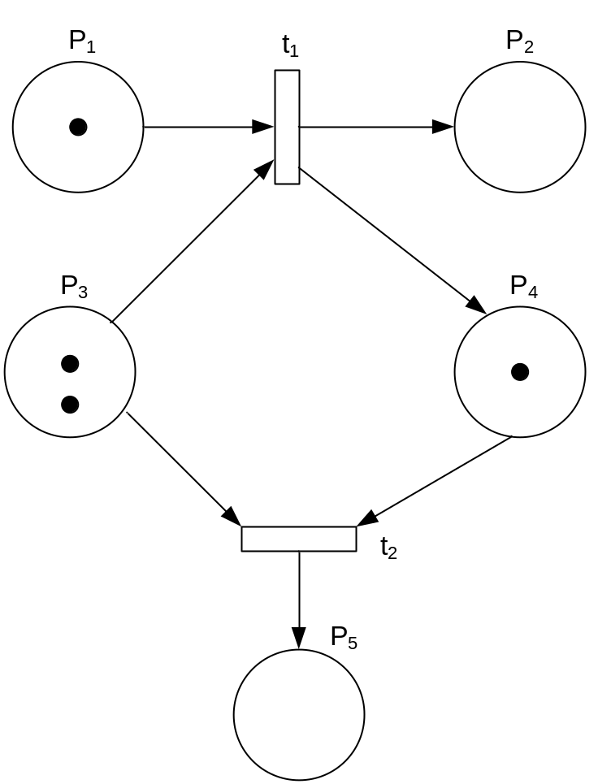
Low-Level Petri Nets (cont’d)
Notes:
M₀ = { (P₁, 1), (P₂, 0), (P₃, 2), (P₄, 1), (P₅, 0) }

Slide 7
Capacity
Arcs have capacity 1 by default; if other than 1, the capacity is marked on the arc.
Places have infinite capacity by default.
Transitions have no capacity, and cannot store tokens at all.
Arcs can only connect places to transitions and vice versa.
A few other features and considerations will be added as we need them.

Slide 8
The Classical Petri net model
A Petri net is a network composed of places ( ) and transitions ( ).
t2
t1
p2
p1
t3
p4
p3
Connections are directed and between a place and a transition.
Tokens ( ) are the dynamic objects.
The state of a Petri net is determined by the distribution of tokens over the places.

Slide 9
p1
t1
p4
p2
p3
Transition t1 has three input places (p1, p2 and p3) and two output places (p3 and p4).
Place p3 is both an input and an output place of t1.

Slide 10
Enabling condition
Transitions are the active components and places and tokens are passive.
A transition is enabled if each of the input places contains at least one tokens.
t1
t2
Transition t1 is not enabled, transition t2 is enabled.

Slide 11

P₁
t₁
P₃
P₂
t₁ enabled
t₁ fired (still enabled)
Notes:
Also for atomic means that process runs to completion, or not at all.. i.e., cannot be interrupted and have a partial fire.
You should be asking yourself how concurrency is modeled if only one transition can fire at a time

Slide 12
Firing
An enabled transition may fire.
When Transition Fires, it consumes a tokens from each input places and produces a tokens for each output places.
Firing is atomic
Multiple transitions may be enabled but only one fires at a time
t2
t2
Firing is atomic.
Notes:
Also for atomic means that process runs to completion, or not at all.. i.e., cannot be interrupted and have a partial fire.

Slide 13
Example

Slide 14
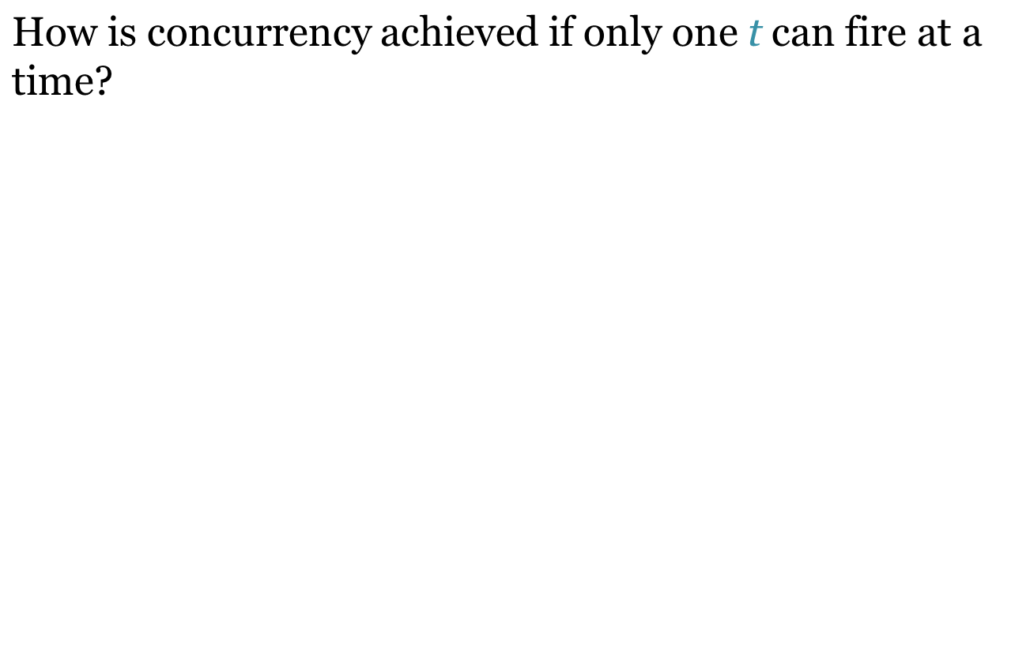
Concurrency
M₀
{t_{2,}t₃}
M₁
t₂
Interleaving Semantics
t₁
t₄
Model assumes that transitions can fire “together” in one step even if true concurrency is not possible on the given implementation
t₃
t₂ and t₃ enabled
t₄ enabled
Notes:
Interleaving assumes a programming model in which transitions can fire together in one step, even if this is not physically allowed by the implementation. Not to be confused with true concurrency where we have multiple processors.

Slide 15
Conflicts
  Two events are said to be in
  conflict if two transitions are
  enabled but the firing of one
  transition disables the other
  Also referred to as decision or
  choice depending on application
  How can conflicts be resolved?
    Purely non-deterministically
    Assigning probabilities to conflicting transitions
t₁
t₂
Both t₁ and t₂ are enabled
Firing t₁ disables t₂

Slide 16
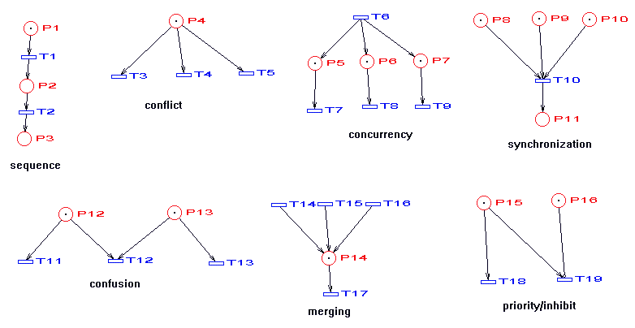
A collection of primitive structures that occur in real systems

Slide 17
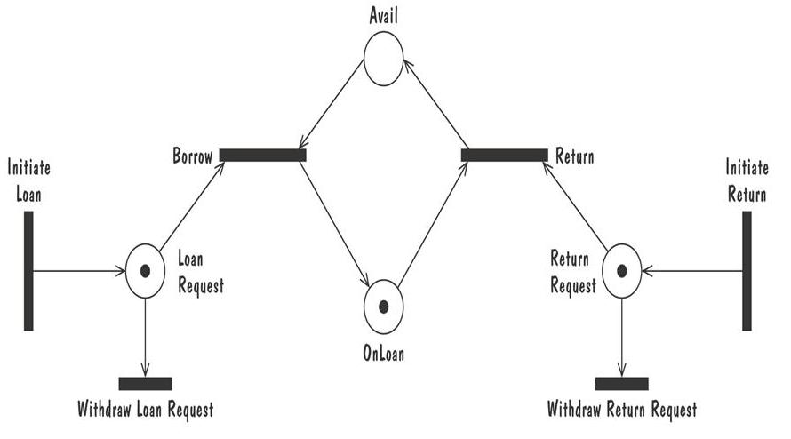
Petri Nets
Petri net of book loan

Slide 18
High-level Petri nets
The classical Petri net was invented by Carl Adam Petri in 1962. Since then a lot of research has been conducted (>10,000 publications).
Since the 80-ties the practical use is increasing because of the introduction of high-level Petri nets and the availability of many tools.

Slide 19
High-level Petri nets
In practice the classical Petri net is not very useful:
The Petri net becomes too large and too complex.
It takes too much time to model a given situation.
It is not possible to handle time and data.
Therefore, we use high-level Petri nets, i.e. Petri nets extended with:
  color (for the modeling of attributes)
  time (for performance analysis)
  hierarchy (for the structuring of models, DFD's)

Slide 20
Modeling
States of a process are modeled by tokens in places and state transitions leading from one state to another are modeled by transitions.
Tokens represent objects (humans, goods, machines), information, conditions or states of objects.
Places represent buffers, channels, geographical locations, conditions or states.
Transitions represent events, transformations or transportations.

Slide 21
To explain the three extensions we use the following example of a hairdresser's saloon.
hairdresser ready to begin
client waiting
free
start
finish
waiting
busy
ready
Note how easy it is to model the situation with multiple hairdressers.

Slide 22
The extension with color
A token often represents an object having all kinds of attributes.
Therefore, each token has a value (color) with refers to specific features of the object modeled by the token.
name: Sally
age: 28
hairtype: BL
name: Harry
age: 28
experience: 2
free
start
finish
waiting
busy
ready

Slide 23
Each transition has an (in)formal specification which specifies:
the number of tokens to be produced,
the values of these tokens,
and (optionally) a precondition.
This results in a compact, manageable and natural process description.

Slide 24
Examples
c := a+b
b := -a
a
+
a
-
b
b
c
a >=0 | b := √ a
a
b
a
sqrt
b
select
c
if a> 0
then b:= a
else c:=a
fi
Extra Credit Exercise:
calculate √ |a+b| using these building blocks

Slide 25
The extension with time
For performance analysis we need to model durations, delays, etc.
Therefore, each token has a timestamp and transitions determine the delay of a produced token.
free
0
3
9
Δ=0
1
Δ=0
start
finish
Δ=3
waiting
busy
ready

Slide 26
The extension with hierarchy
A mechanism to structure complex Petri nets comparable to DFD's.
A subnet is a net composed out of places, transitions and subnets.
h1
h2
waiting
h3
ready
free
start
busy
finish

Slide 27
Exercise: remove hierarchy
h1
h2
waiting
h3
ready
free
begin
pending
end
start
busy
finish
begin
pending
end

Slide 28
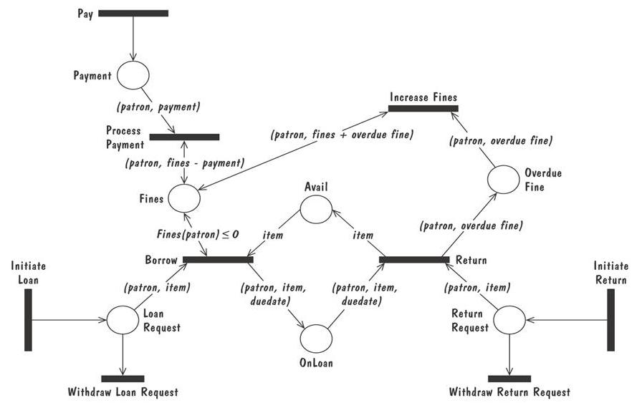
Petri Nets
A high level Petri net specification for the library problem

